Slide 1


The most comprehensive ERP solution for schools in the world!

Slide 2
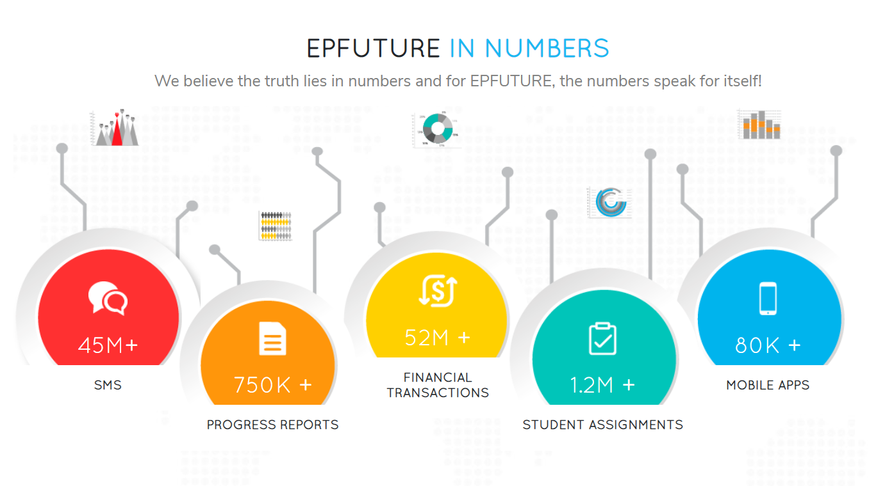
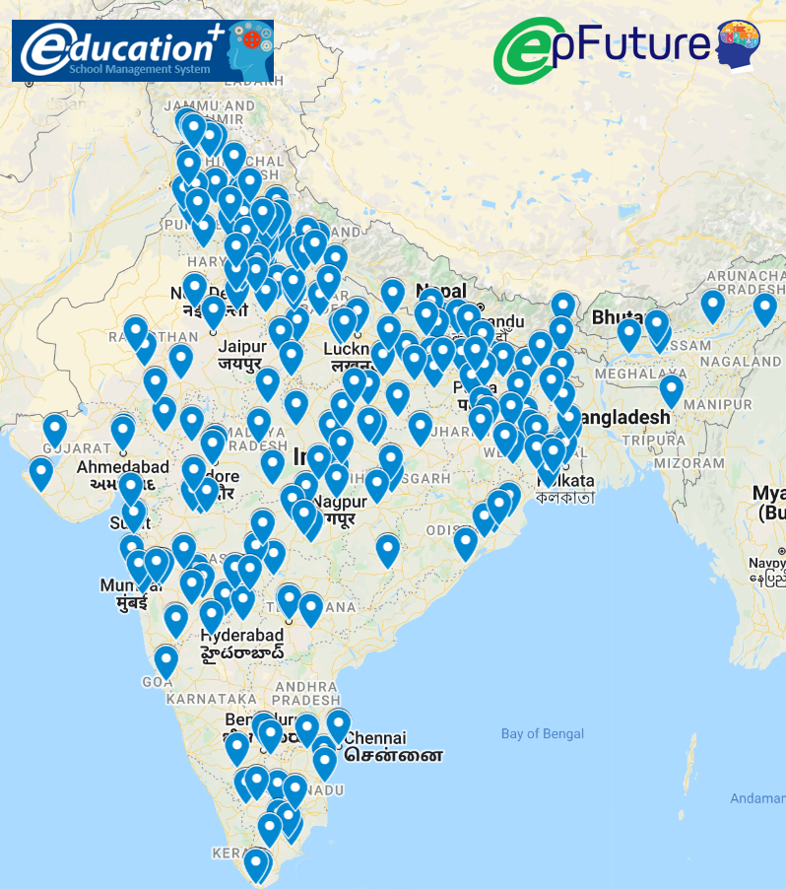
The Numbers speak for itself !

Slide 3
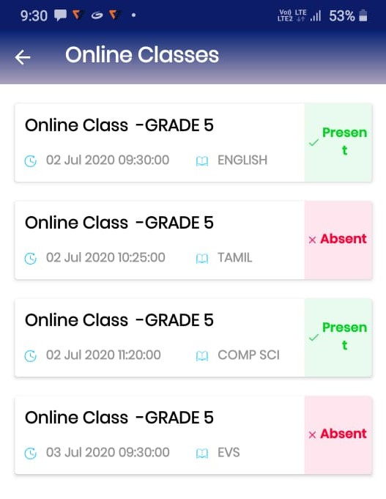
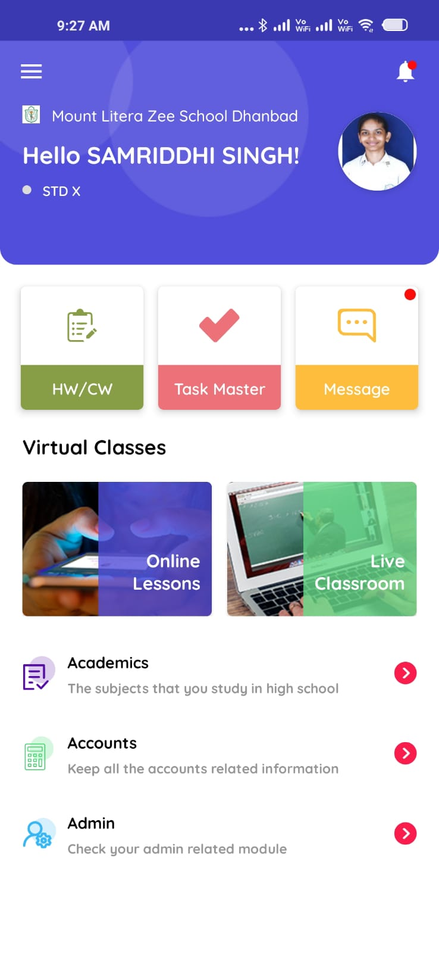
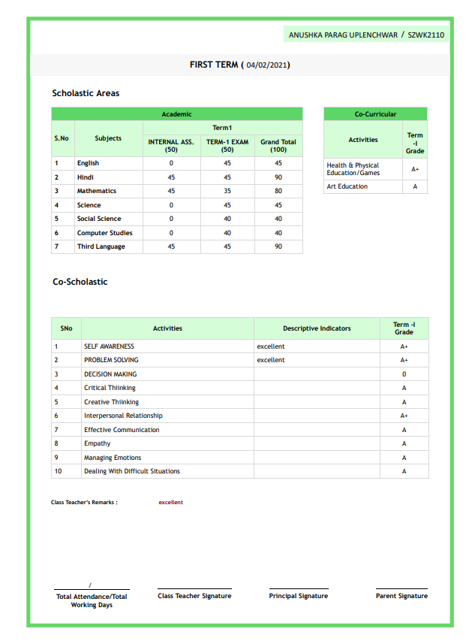
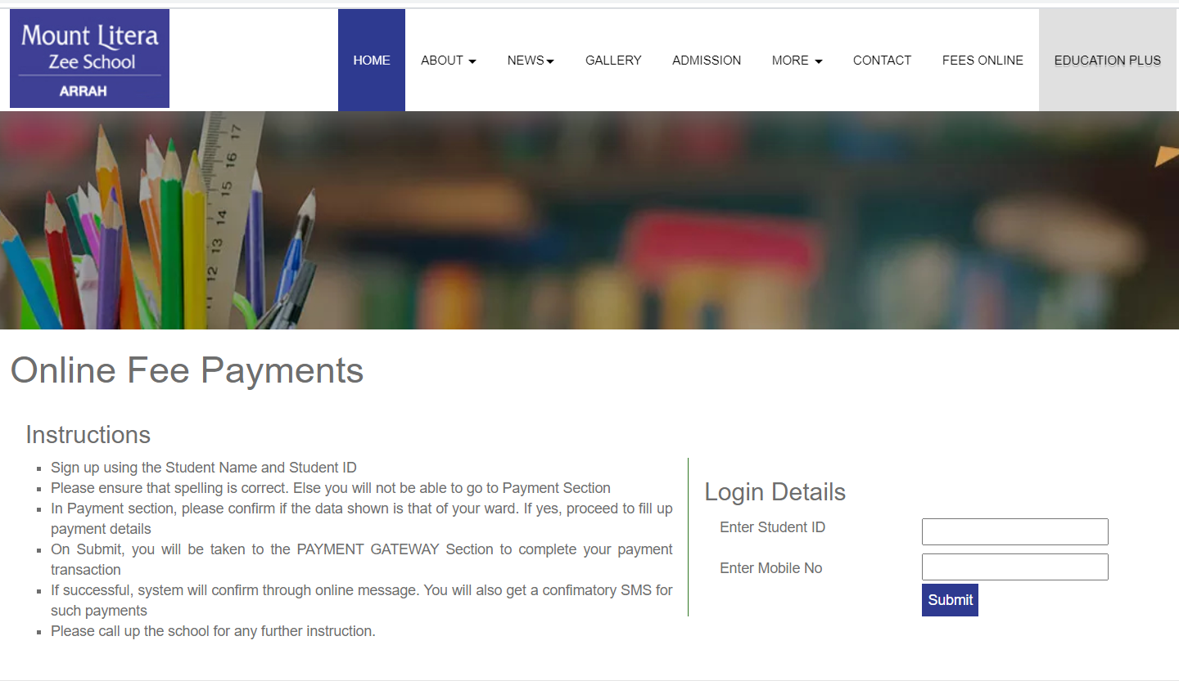
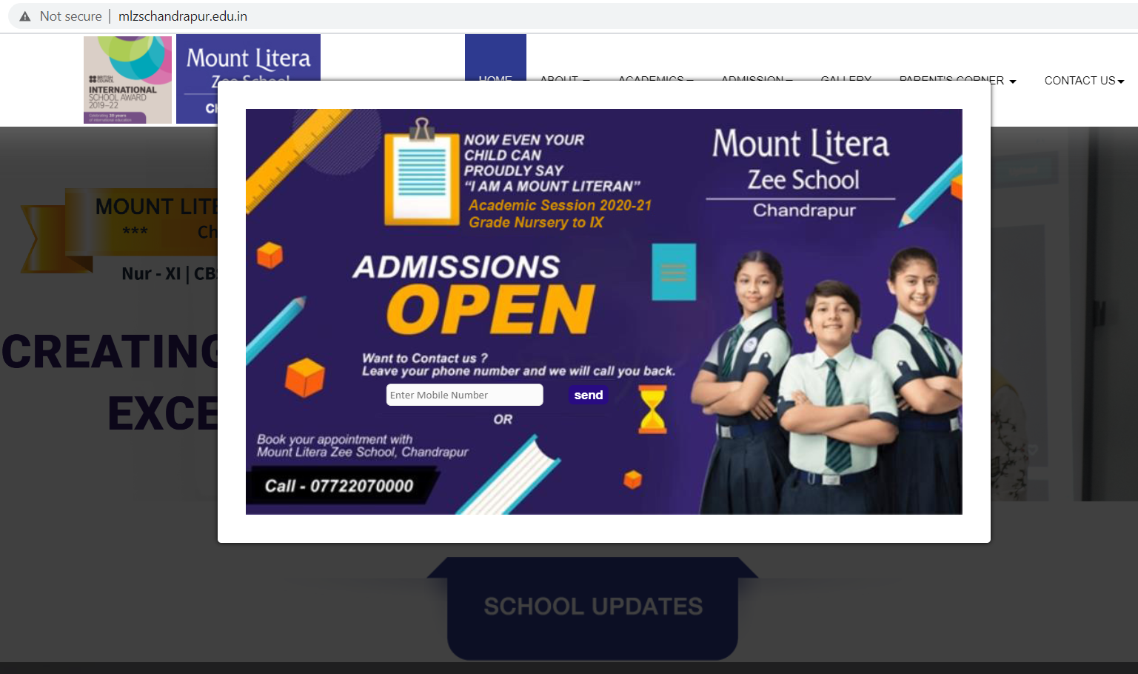
The EPFUTURE Advantage!
Productivity Tool
User Convenience
Finance Plus
Academic Plus
Visibility Plus
Automated Attendance, Online Fee Collection, Online Classes and much more …
Exclusive Mobile App for Student and Staff convenience
Fee management to Book Keeping.. No money lost at any stage
From timetable to progress report card.. Every aspect of academic operation covered
Integrated School Website managed through ERP at every step

Slide 4
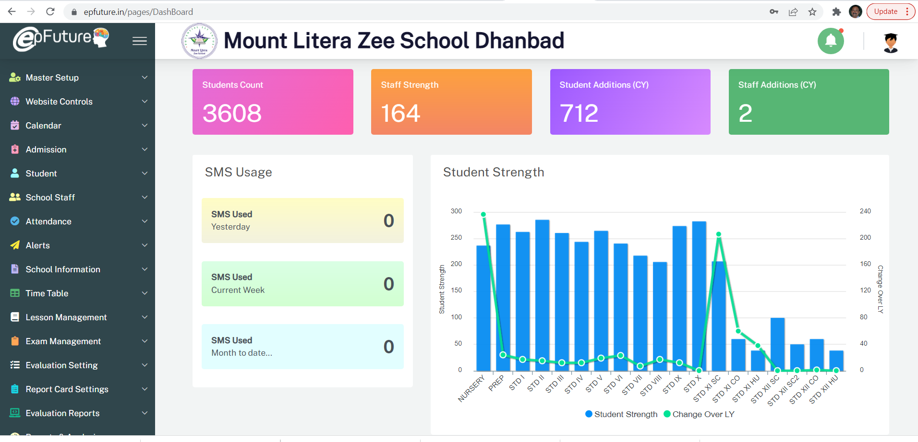




Comprehensive Solution!
Admission
Academic
Lead Generation + Online Admissions – seamless process
Timetable to Progress Reports.. 6 modules manages it all!
Admin
Accounts
Alert, HR, Communication.. All under one roof
Fee Collection to P&L Statement. EPLUS covers it all
EPFUTURE ensures all the 4 Pillars of School Operations are covered efficiently & seamlessly through its 40 independent modules

Slide 5
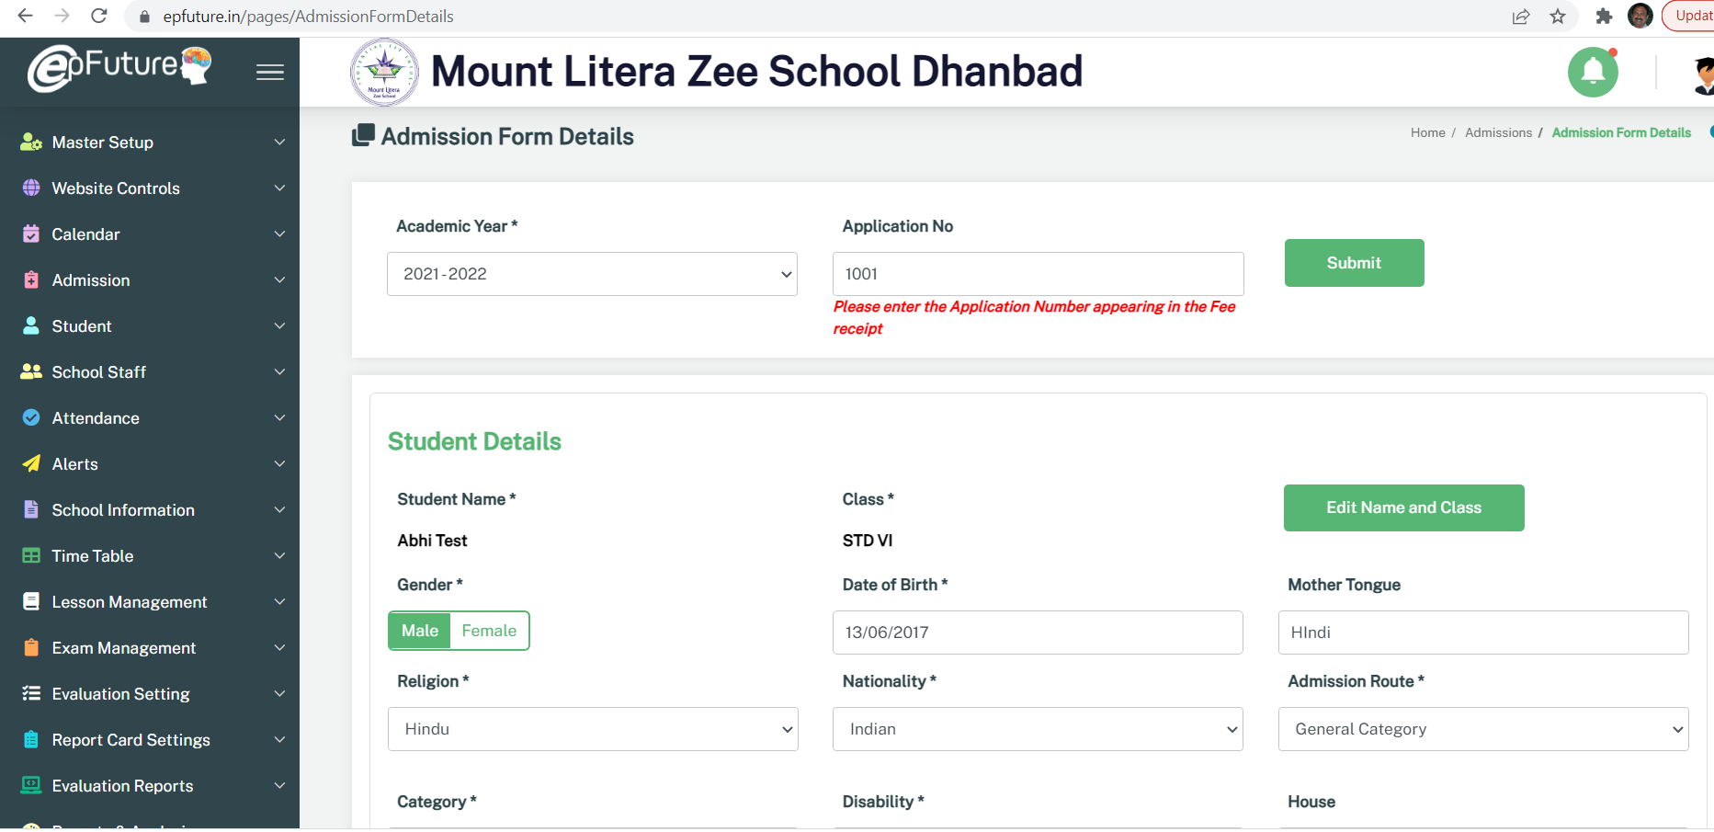




Admissions
Lead Generator
Online Admission
Track every enquiry / visitor & follow-up effectively
Go fully paperless & efficient on Admission process
Selection Process
Zero Error
From Lead Generation to Online Admission Process to Formal Enrollment… EPLUS Tracks it all effectively & conveniently
Direct or Via-Exam. Manage both types of admission easily.
Full step-by-step monitoring reports, 100% accurate results

Slide 6
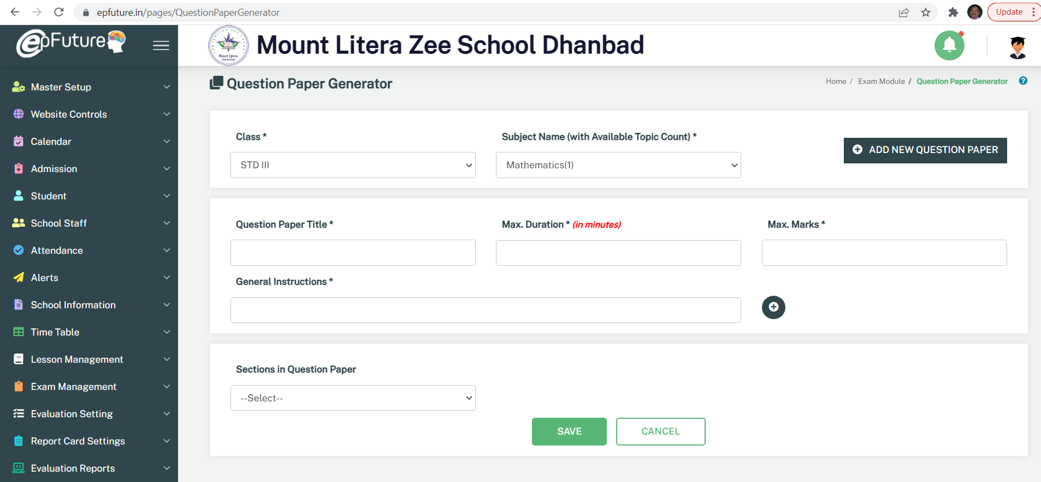




Academics
Timetable
Assignments
Easy to complex timetable setting available
HW & CW assignments accessed via mobile apps
Assessments
Progress Reports
Easy Timetable Scheduling, Assignment sharing via mobile app, Question Bank and Automated QP Generator, Multiple Progress Reports and …
Question Bank and QP Generator helps assessment process
Fully automated multiple option progress reports

Slide 7
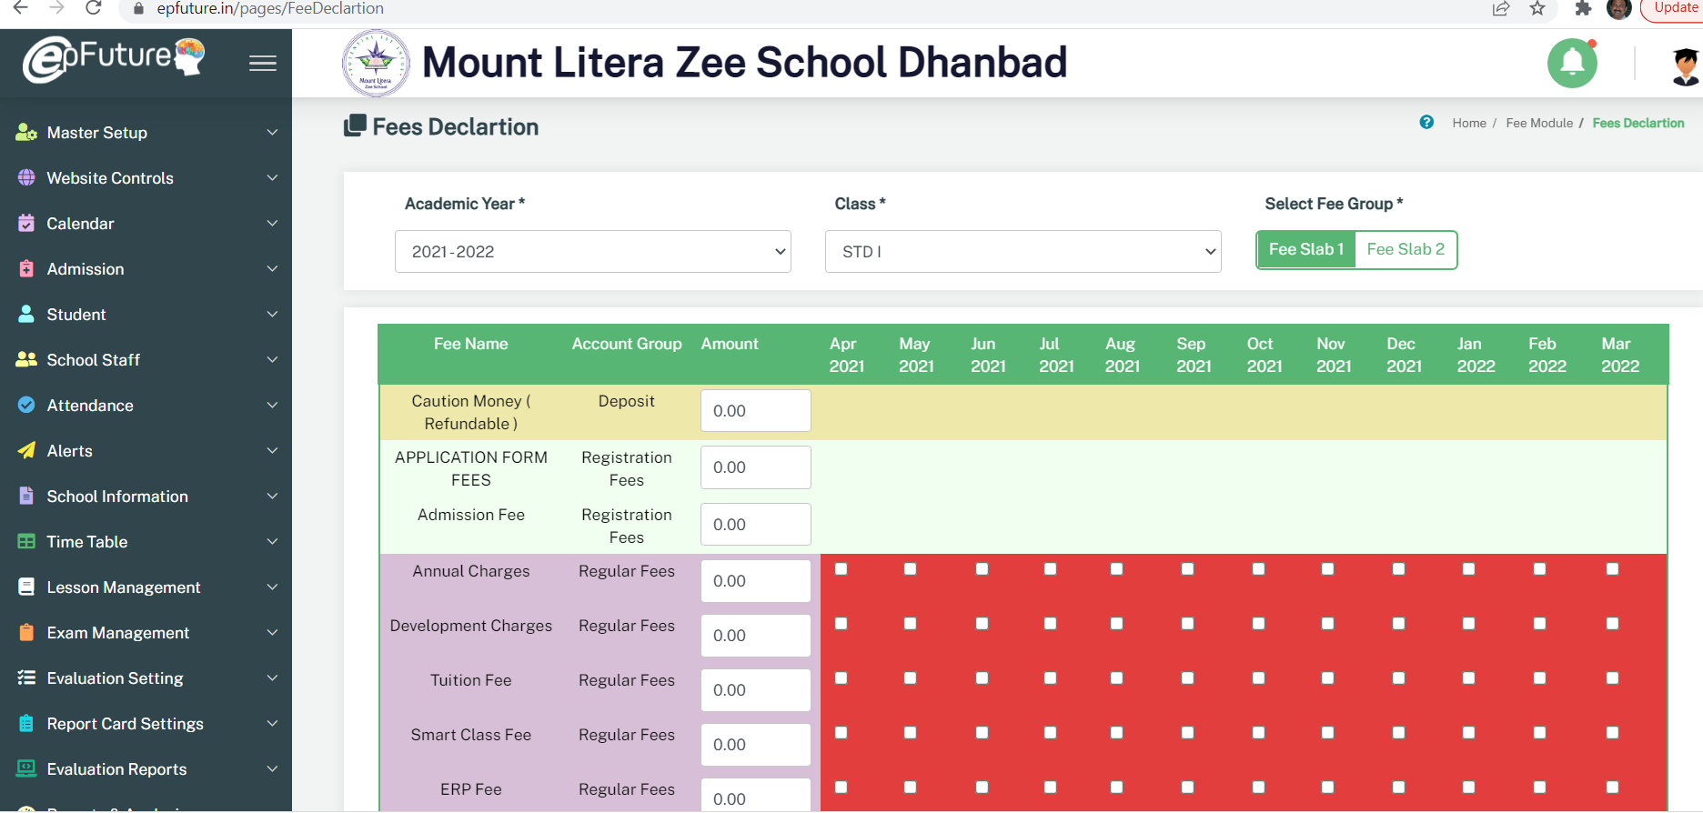




Accounts
Fee Management
Transport & Hostel
Manual to Online Fee Payment – all options readily available
Hostel & Transport management
Asset Management
Full Accounting
Anything about money gets covered on EPLUS : fees, concessions, hostel, transport, payroll, canteen, Assets & Inventory… right upto P&L
Full asset & inventory management with QR code options
Full accounting with P&L & Balance Sheet options

Slide 8
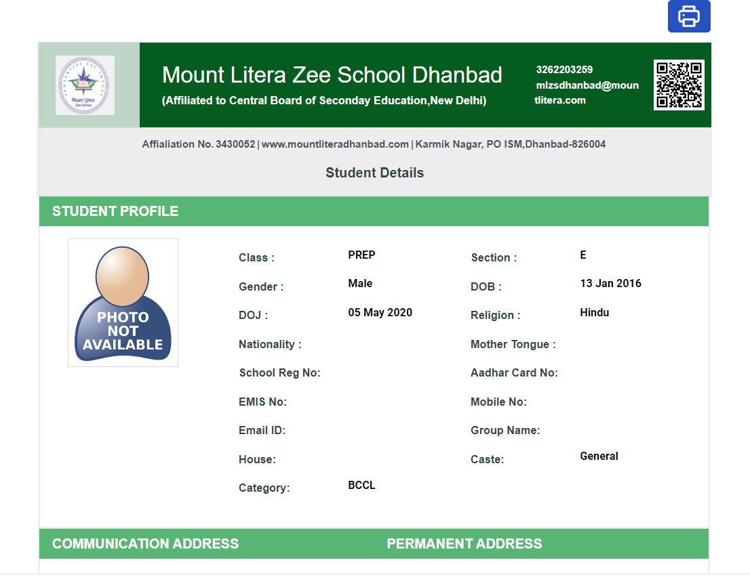




Administration
Website Control
Communication
Fully integrated sites controlled by EPLUS
SMS, Email plus Automated Alerts
HR & Leave Mgmt
Attendance
Full control on School operation which includes Integrated Website, Staff Management, Attendance (Manual & Automated), Communication and Alerts …
Complete staff management right upto Payroll management
OnMobile Attendance using GPS GeoFencing

Slide 9
What’s new in EPFUTURE
FUTURISTIC APPROACH
Moving over from Information Application to Decision Support System for all users!
Focus on Increased security around the application
QR Code based tracking of every print activity
Access trackers now with Management team as well
More flexible user roles – Schools can create their own roles for special staff. In any case, we have added two critical roles : Relationship Manager role & Principal/head teacher role
Schools can add additional modules /pages for individual use based on schools own convenience
Mobile Notification Alerts for all critical messages ( HW, CW, Mobile Alerts) for all App users!
Using Google Firebase service, we have adopted automated alerts for all the critical messages that are being sent.

Slide 10
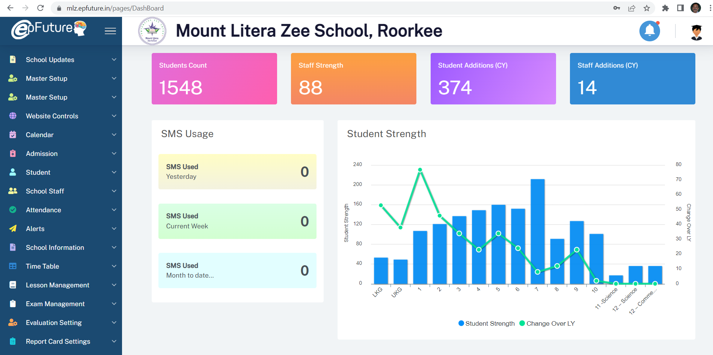

Slide 11
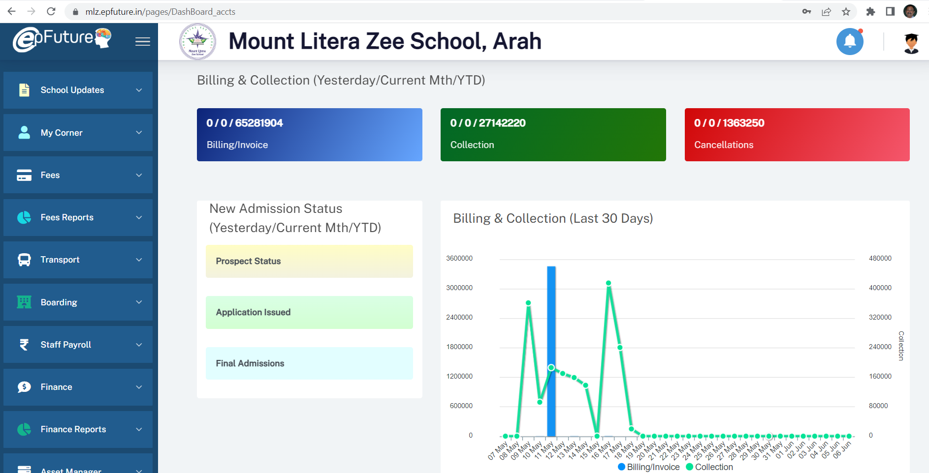

Slide 12
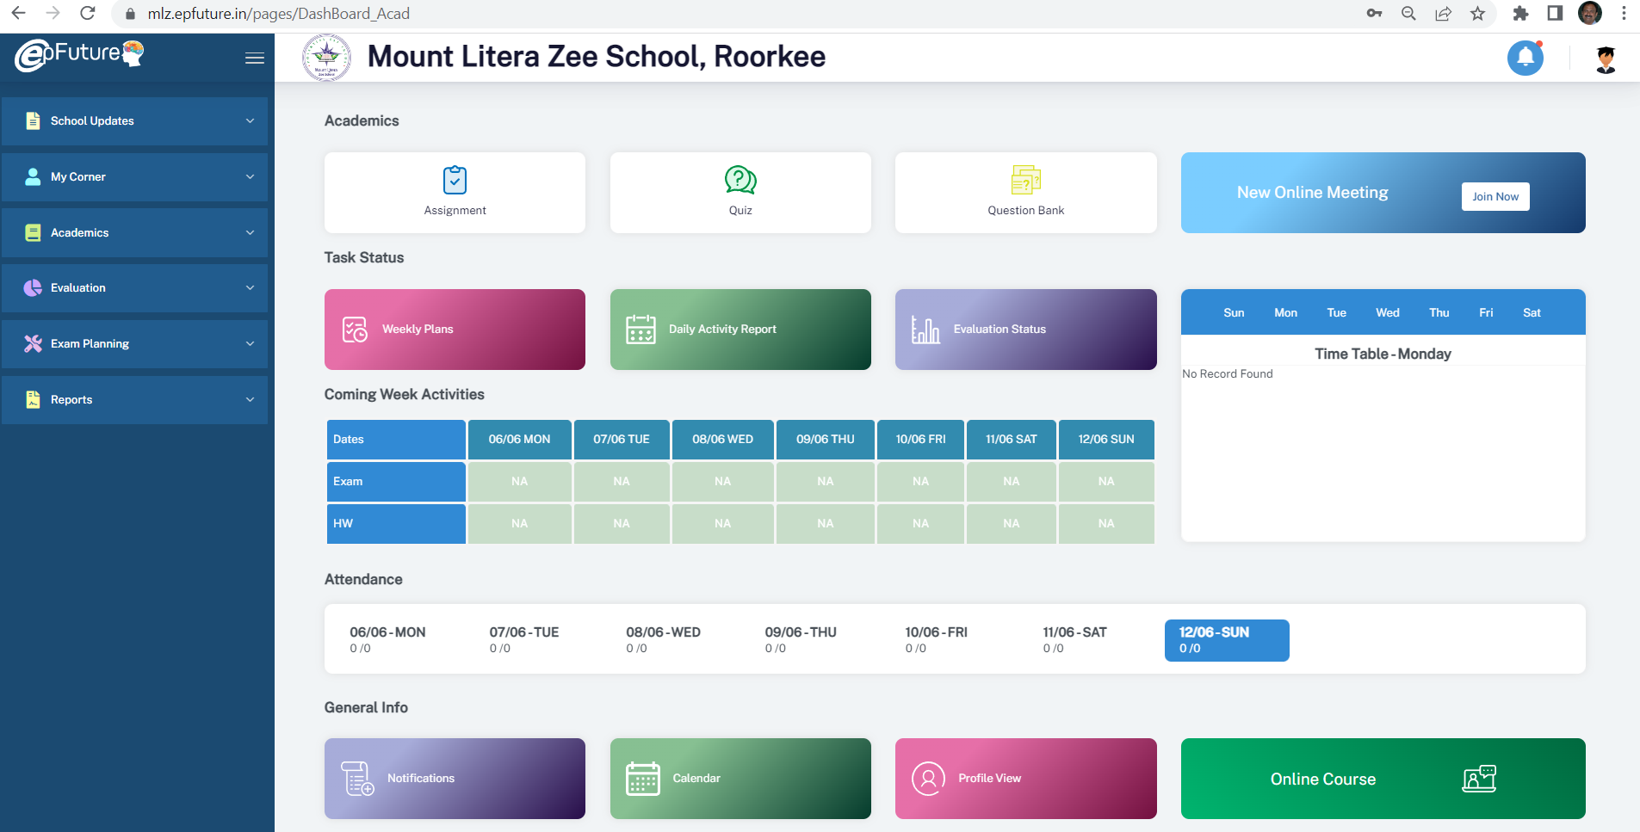

Slide 13
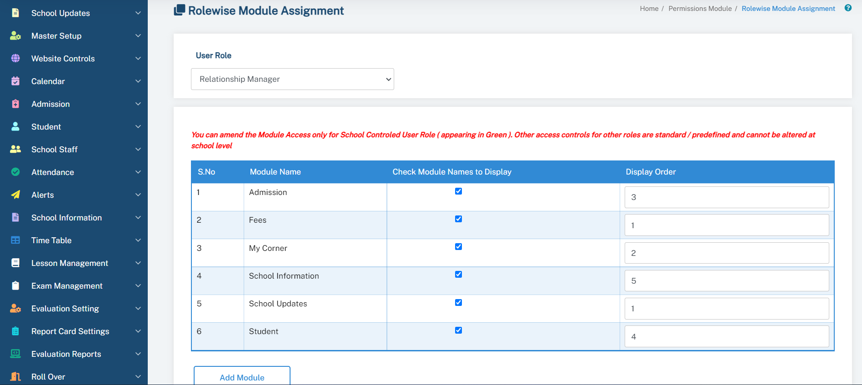

Slide 14



Slide 15
What’s new in EPFUTURE
NAVIGATION BAR MADE POWERFUL
Alerts / Inbox and Outbox part of Navigation bar
Last use details to enable user track their own usage ( identify any misuse )
New feature added for all users – Task tracker : a feature that enables users to keep track of their critical tasks and reminders
“Assist” feature to answer critical points related to page there itself.

Slide 16
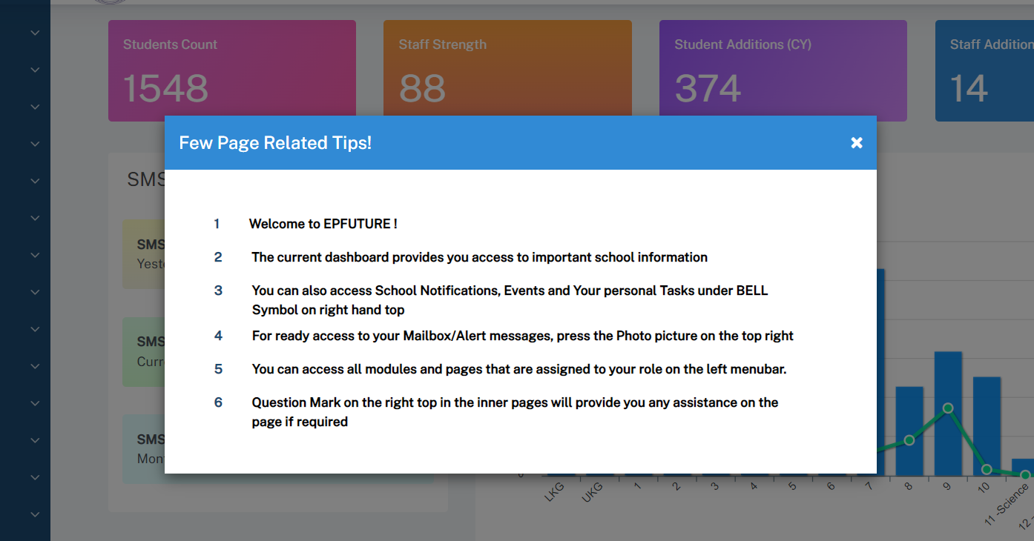

Slide 17
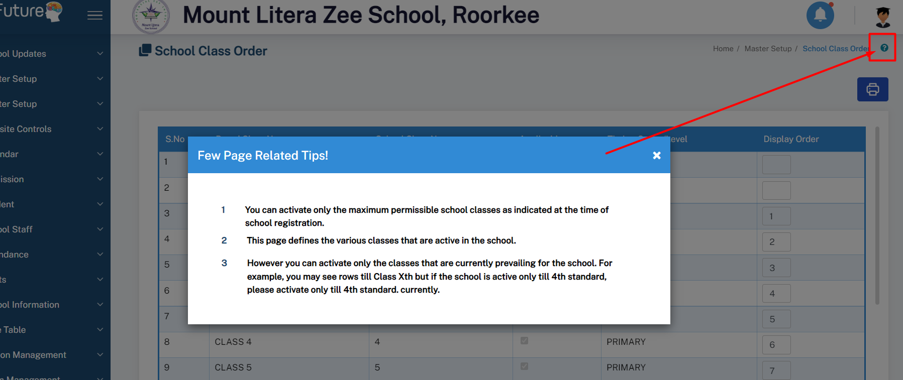

Slide 18
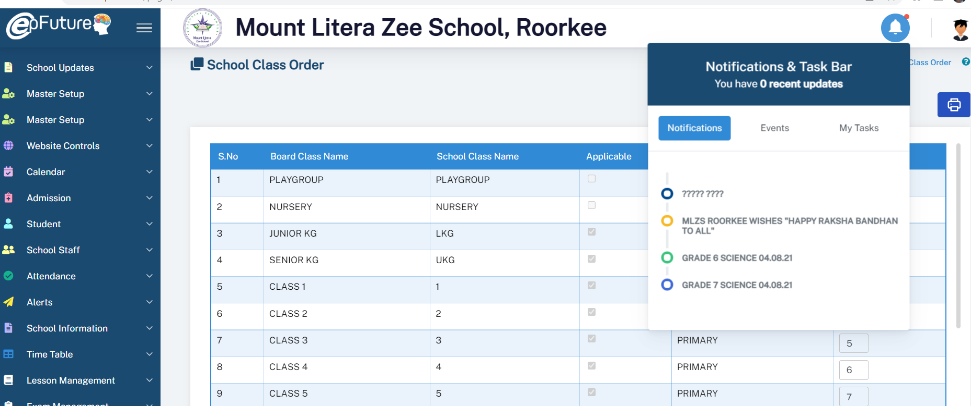

Slide 19
What’s new in EPFUTURE
ACADEMIC EXCELLENCE
Teacher’s training tracker module
Question Bank, Quiz and Question Paper Generator
Online Classes and Online Assignments (both objective and subjective questions)
Self practice quiz option for students on their mobile app
Online Homework for students with option for online submission and feedback by teachers
New Report Card templates
Complete mobility for teachers – Almost 100% of their activities managed from mobile

Slide 20
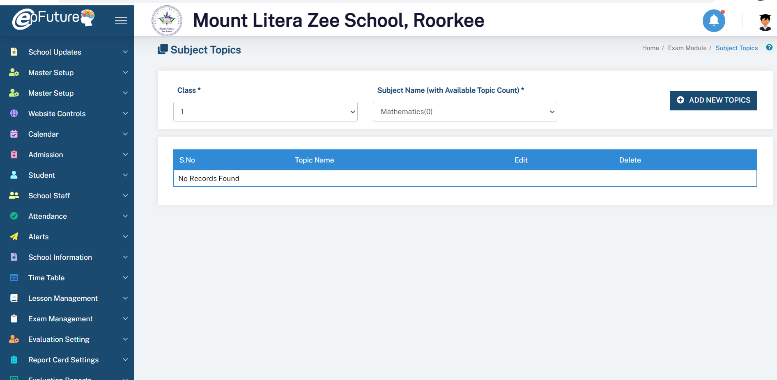

Slide 21
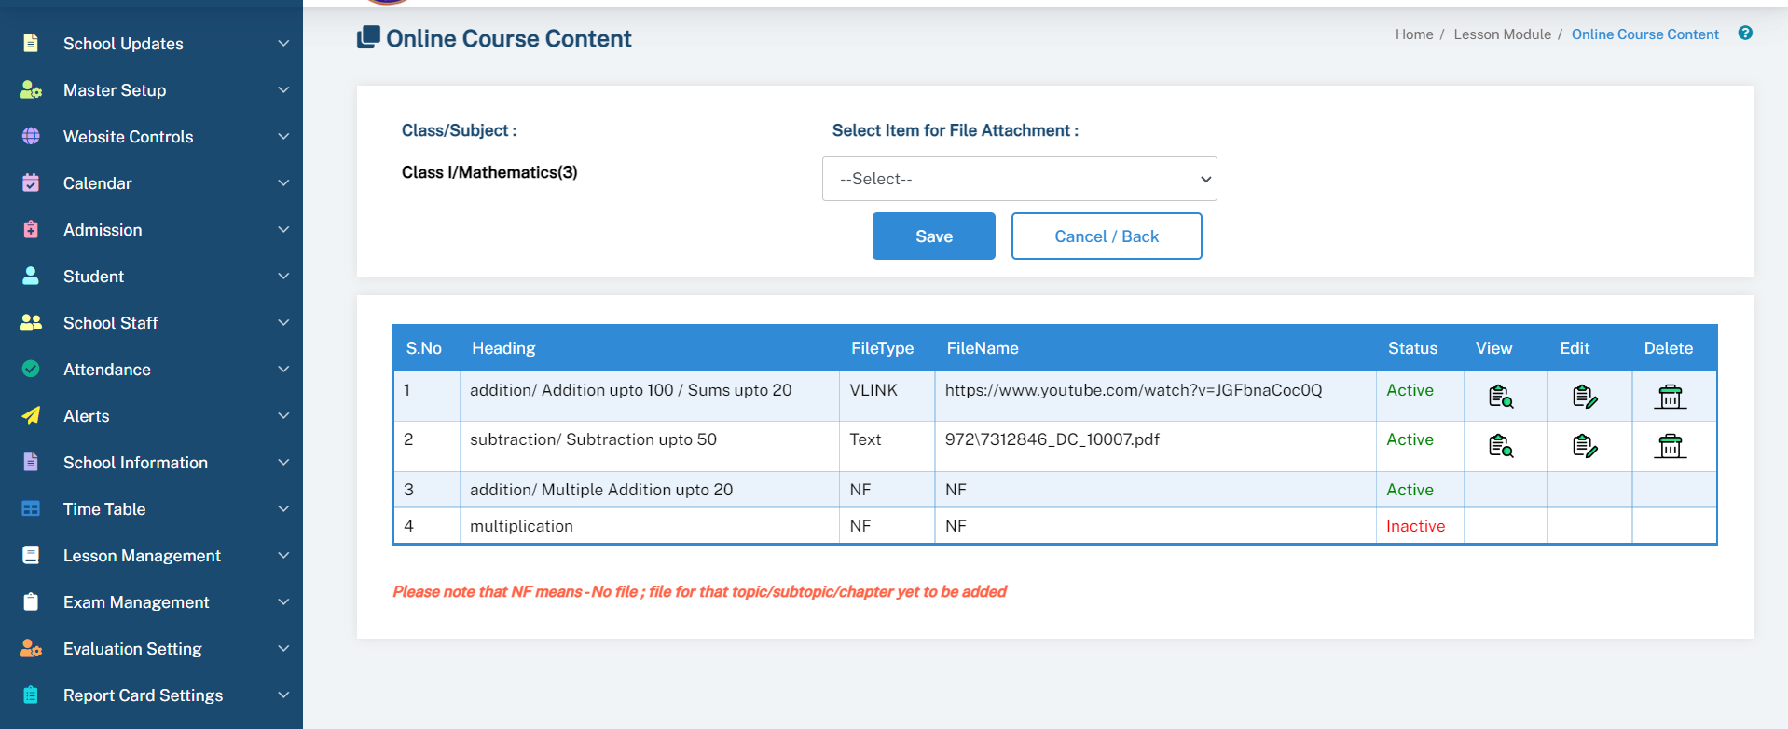

Slide 22
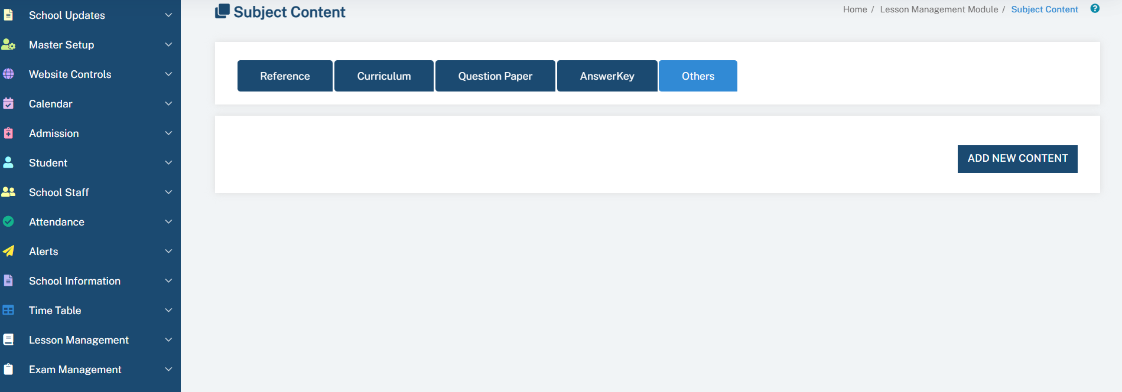

Slide 23
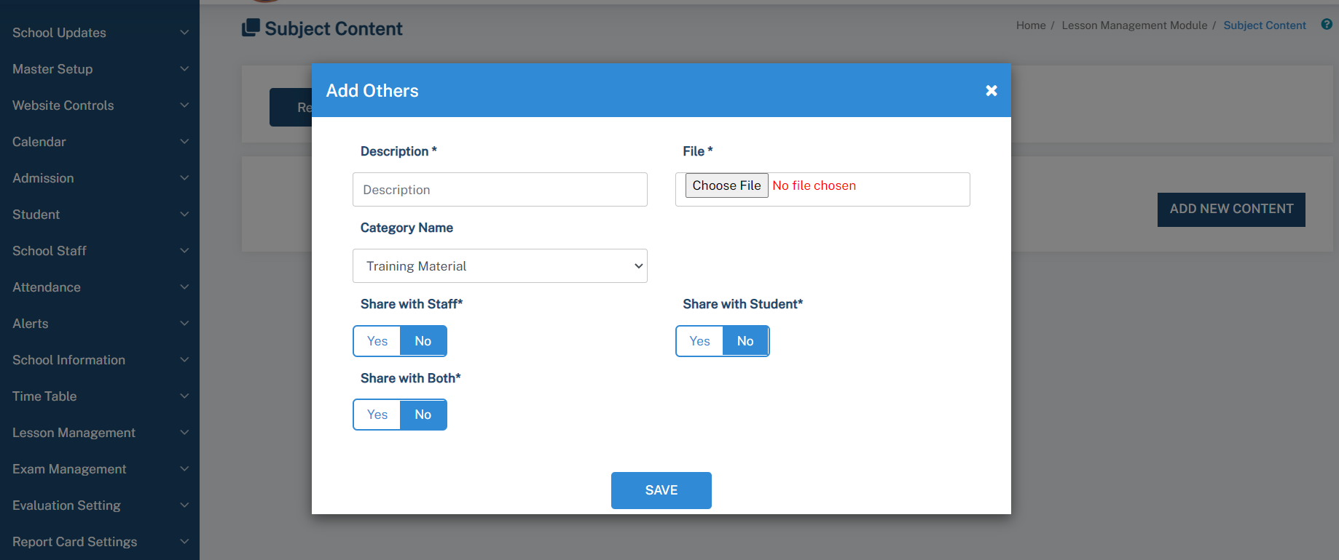

Slide 24
What’s new in EPFUTURE
ACCOUNTING PERFECTION
More controls to the finance team – Distinct roles for separate users
Comprehensive Salary Accounting module
Transportation Costs control trackers – elementwise
Management Alerts on Daily collections
Mobile Notification alerts for payments, invoices and also fee dues ( not dependent on SMSs anymore)
Invoice grouping, if required by schools

Slide 25
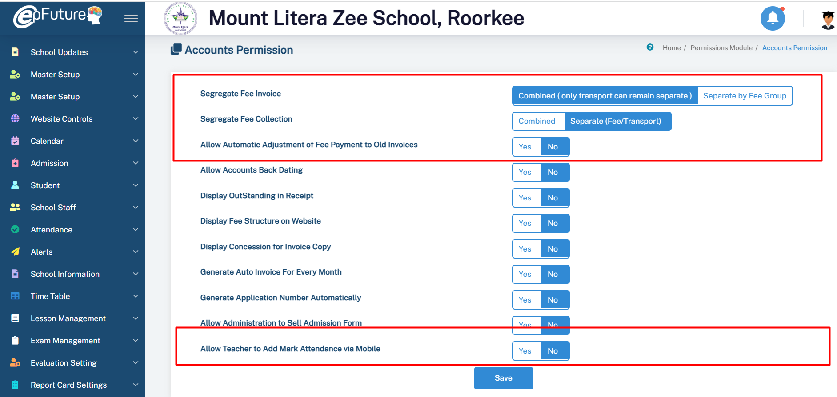

Slide 26
Your constant companion!
Simple & Secure
Role based Interface
Access Controls to limit user to specific areas only
Complete protection – “hack proof”
24*7*365 access anytime and from anywhere

Slide 27
What’s new in EPFUTURE
BETTER ADMINISTRATIVE CONTROLS
Common access to all information from HO instantly
Flexible administrative roles based on requirement
New user features like Tasks for daily reminders of pending activities
Print and Download options for most reports
Instant information on all critical activities via comprehensive Management Mobile app
Dynamic Dashboard for ready access to critical information
Automated Online Attendance for staff from their mobile ( based on School Wifi integration– no hardware required)

Slide 28

Outstanding Features !
Must-use features from EPFUTURE !

Slide 29
Your constant companion!
Simple & Secure
Role based Interface
Access Controls to limit user to specific areas only
Complete protection – “hack proof”
24*7*365 access anytime and from anywhere

Slide 30

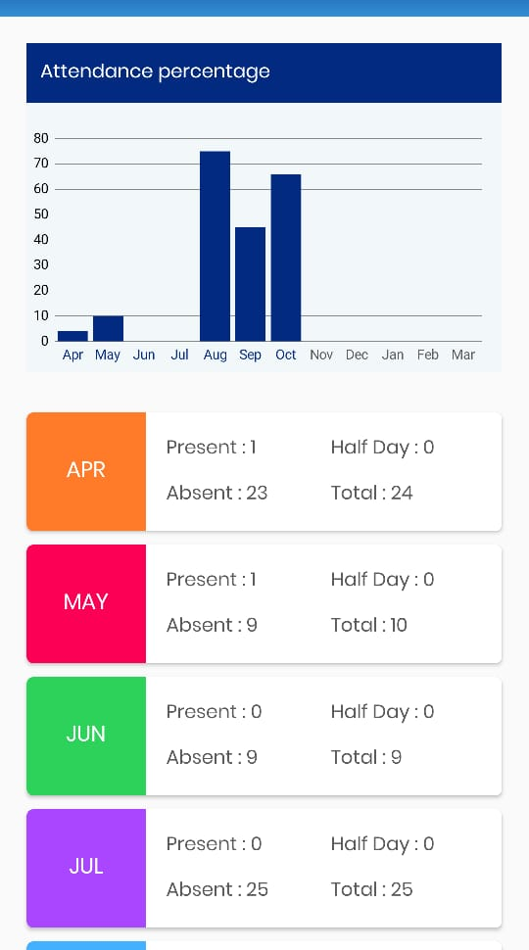
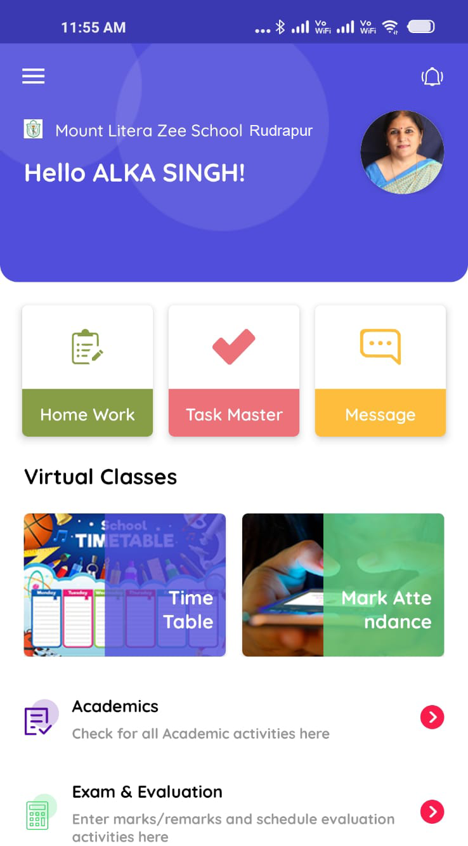
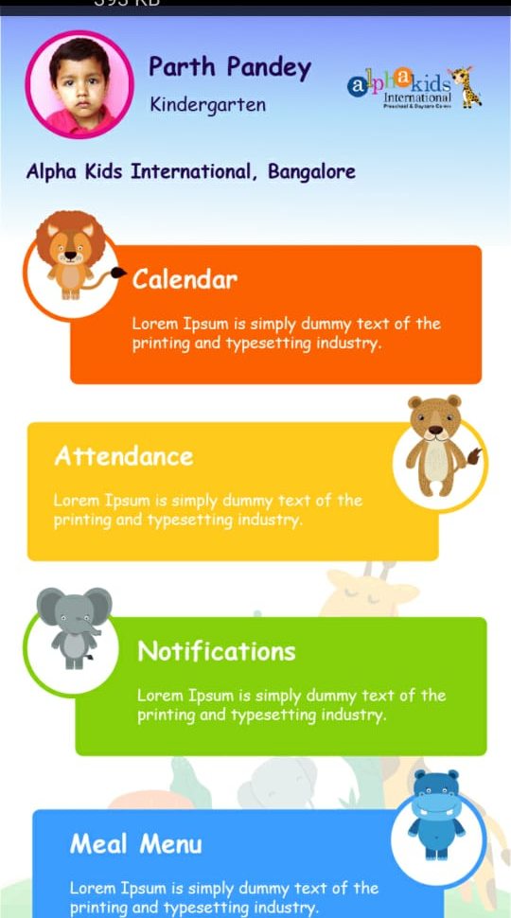

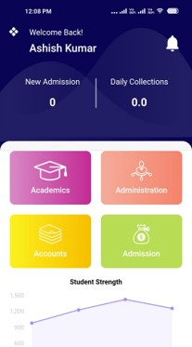
Mobile Apps that keeps everyone Informed!
Students App
Staff App
KinderGarten App
Management App

Slide 31
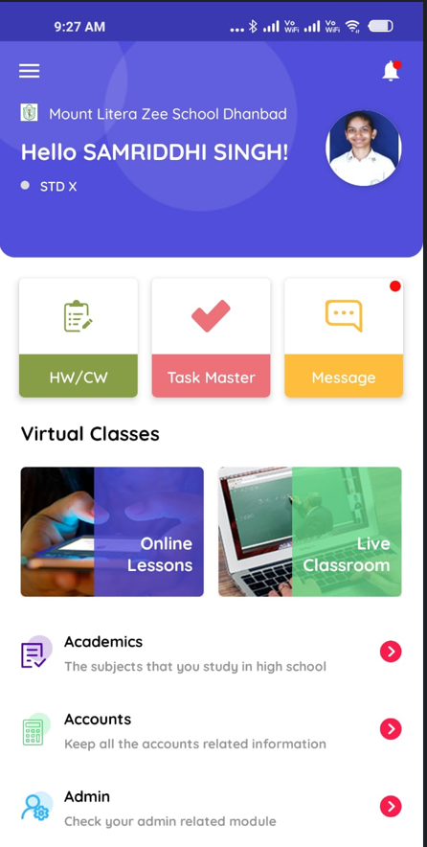

Fun Zone on EPFUTURE !

Slide 32

Integrated Websites via EPFUTURE!

Slide 33

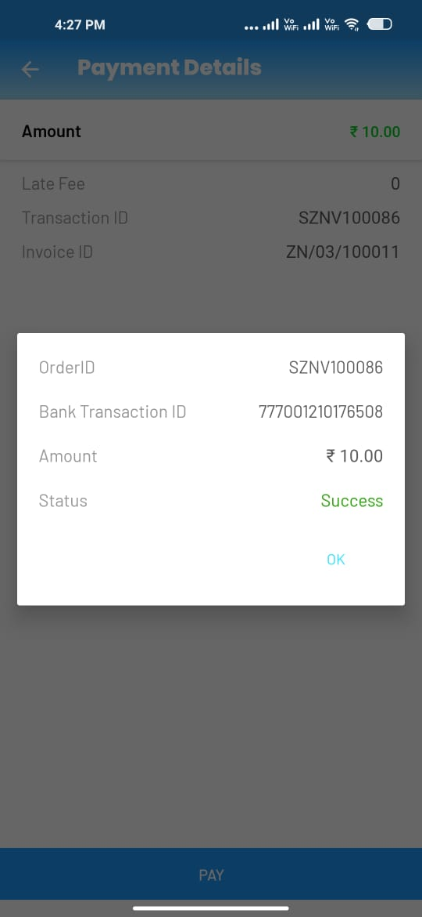
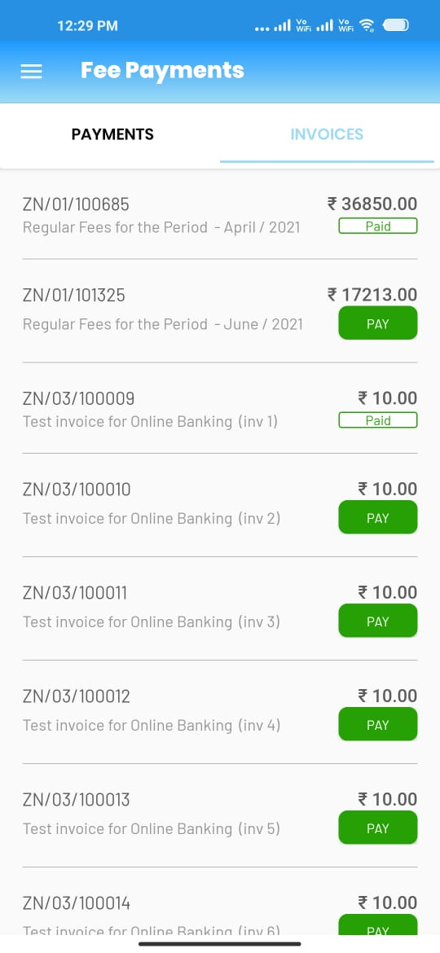
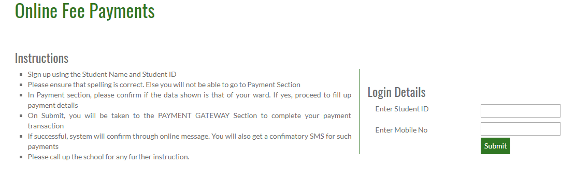
Online Fee Collections
Convenient fee payment options via Mobile or through School Website

Slide 34


Online Classes & Exams
Integrated solution with Zoom & automated attendance tracking. Option for Online Exams also available on EPLUS for students

Slide 35





Reward performances !
Instant gratification for good performance through ready-to-use Certificates sharable on mobile app as well!

Slide 36

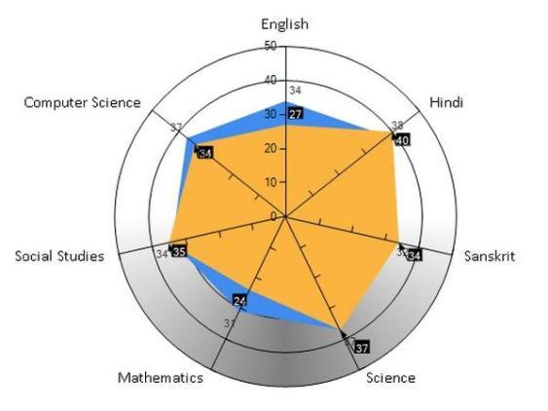
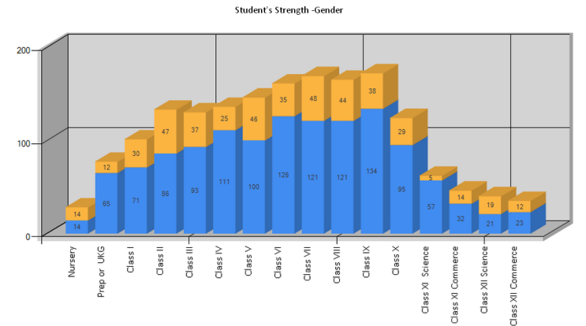
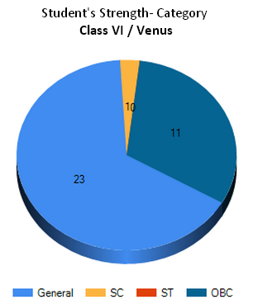
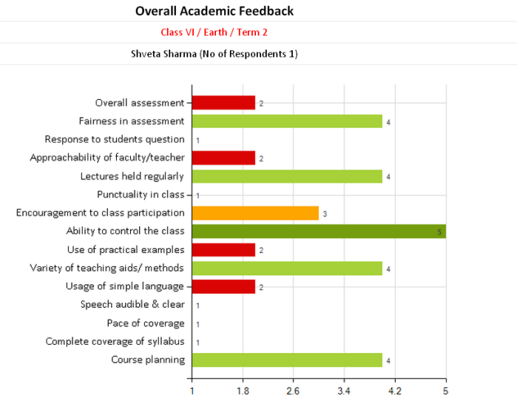
Analysis & Feedback
Over 300 + reports plus graphical analysis on student performances available for ready use.

Slide 37






Thank You
Ms.Kamini Patel
+91 44 47430275
customercare@innovasphere.n
https://epfuture.in

